Slide 1
Data pruning for cost-efficient training in tribological analysis on journal bearing systems
Karim Elkobrossy

Slide 2
Introduction
Notes:
* Introduce Journal bearing , tribological analysis, Data pruning

Slide 3
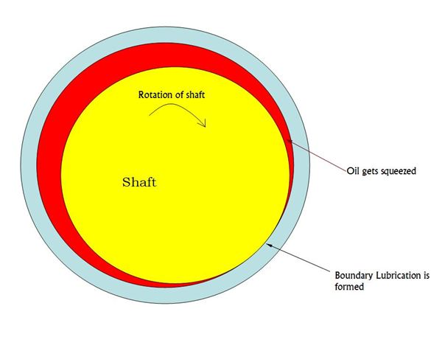
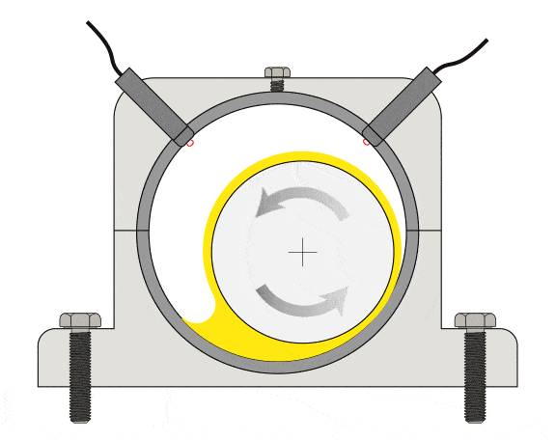
Journal Bearing
Tribological analysis
Dataset acquired from Hydrodynamic Lubrication Solver [3]
Images references:
1) https://mechasource.blogspot.com/2018/03/an-introduction-to-journal-bearings.html
2) https://ivctechnologies.com/2022/04/04/journal-and-rolling-element-bearings-advantages-disadvantages-of-both/
3) J. Layton, B. Rothwell, S. Ambrose, C. Eastwick, H. Medina, and N. Rebelo, “A new thermal elasto-hydrodynamic lubrication solver implementation in openfoam,”
Lubricants, 2023. Paper currently under review. Manuscript ID: lubricants-2470466.
Notes:
Journal, bearing, lubricant between.
Pressure -> target variable (Prediction). Inputs -> speed, load, angular and axial position.
Dataset collected (HLS), suffers from massive volume (around 65 million instances).

Slide 4
Data pruning
How?
Reduction of dataset
Dimensionality reduction (feature selection)
Reduction of records (Data sampling)
Discretization of values
Notes:
Selecting relevant/most important features to decrease no of features.
Selecting most representative instances, removing redundant, irrelevant or noisy instances to decrease no of instances.
Compressing continuous values into bins to reduce the range of values.

Slide 5
Motivation/Aims

Slide 6
Motivation / Aims
High computing cost
Saving energy
Gap in instance reduction literature in regression
No instance reduction applied before on journal-bearing
Supervised learning to prune dataset using representations
Retaining small representative proportion of dataset
Model’s performance vs data prune percentage
Notes:
Our dataset has 65 million instances that consumes a lot of training resources when training a model.
Intelligently selecting representative instances to train on

Slide 7
Contribution

Slide 8
Contribution
Filling literature gaps by introduction of:
Novel multi-tasking autoencoder (reg autoencoder)
Modified Selesup algorithm
Novel adaptive DBSCAN
Comparison between those algorithms
Demonstrating the effect of changing pruning percentages
Notes:
Adjust the proximity of the data points in the latent space based on the closeness of features and relevance to the target variable.
primarily targeting classification problems and using it in our regression problem
Tailored to our problem to reduce the number of instances.
along with random sampling and training on the full dataset in terms of mean absolute error performance and training time.
On regression autoencoder and random sampling

Slide 9
Methodology
Notes:
3

Slide 10
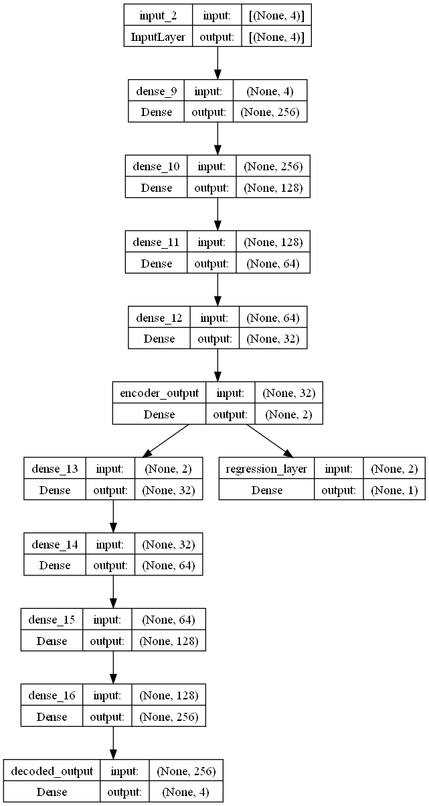
Regression Autoencoder
Multi-task learning : Adjusts proximity on closeness of features, target
2 combined loss functions:
Reconstruction loss
Prediction loss
Mirror architecture
Encoder -> bottleneck -> Decoder
Cluster embedding, use stratified sampling for instance reduction
Notes:
Why? Some features are very close but has dissimilar target variables. We want to separate those groups

Slide 11
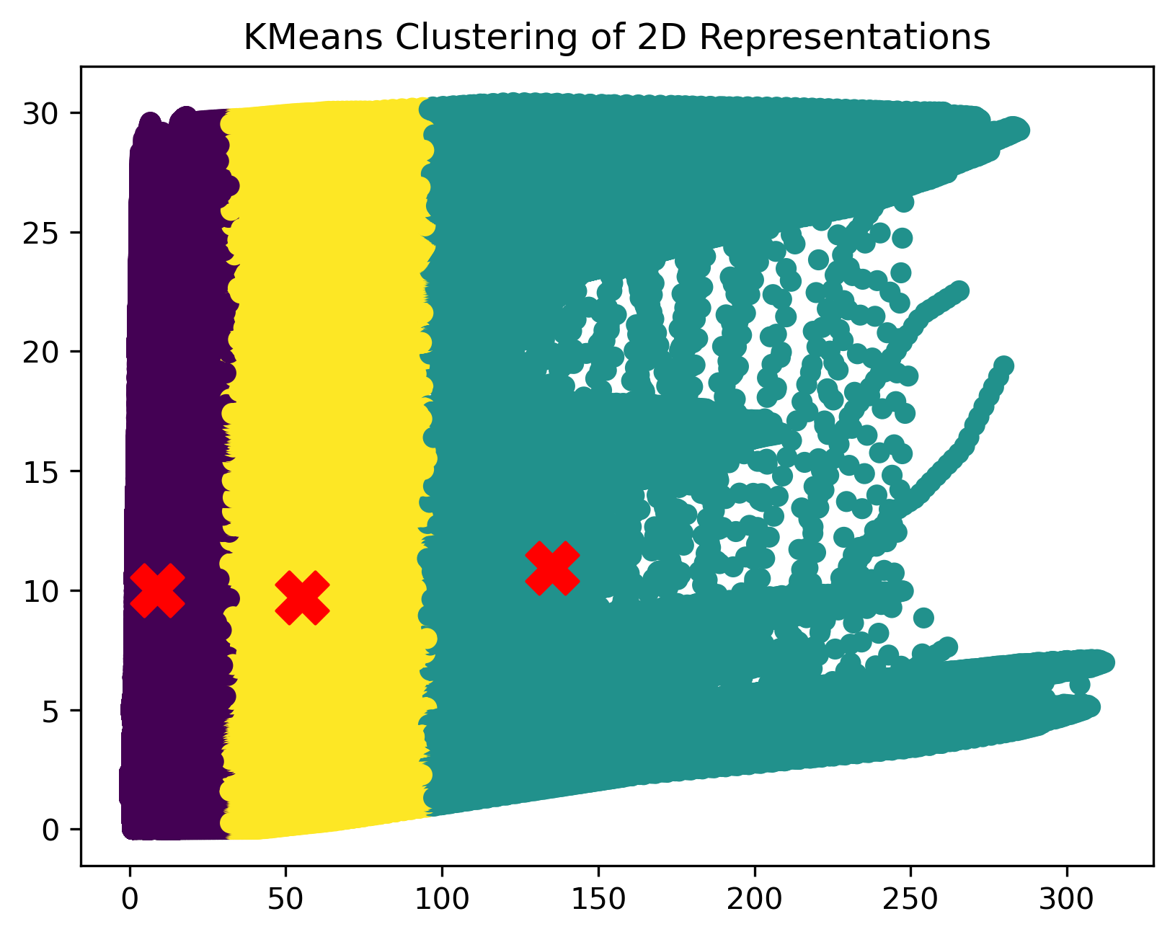
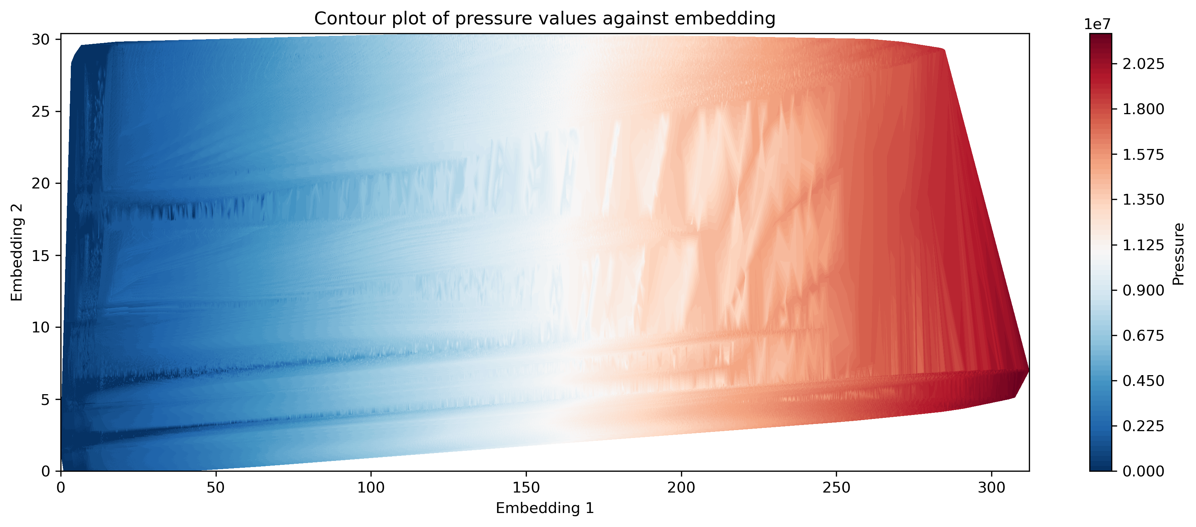

Slide 12
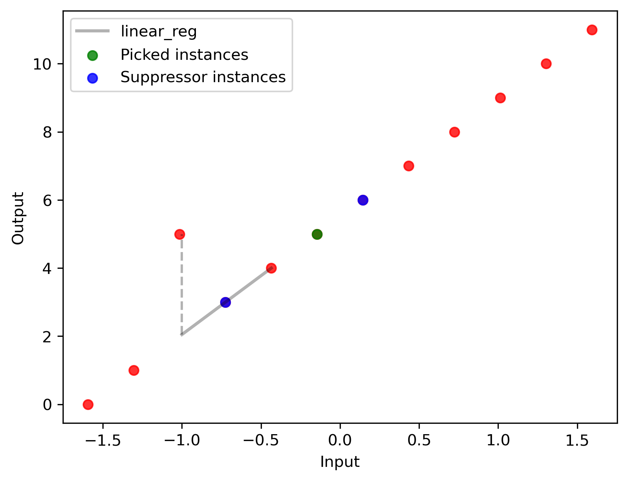
2) Regression Selesup
Split to WBC and pathogens by f
Compute 2 NN for each pathogen
For each pathogen:
Linear regression between pathogen and 2nd WBC to predict target of 1st WBC (y_{_first_WBC})
Diff = abs(y_{_first_WBC} – y_{_first_pred_WBC})
Thresh = Std(y_{_pathogen},y_{_second_WBC})
If diff < threshold:
Increase score of first WBC
Collect all WBC having scores > 0
Notes:
Originally -> Eliminating data irrelevant to classifier
Why? less computationally expensive than evolutionary and genetic algorithms

Slide 13
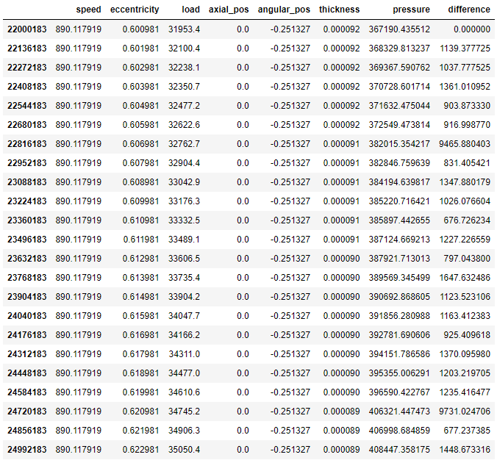
Adaptive DBSCAN
Dataset reshaped in 2D
Difference column (pressures)
Std, mean (difference column)
DBSCAN parameters:
Epsilon = mean + std
MinPts = 1
Notes:
For Every combination of other variables, load and pressure change against each other
Difference column -> difference between pressure in subsequent rows
Epsilon local to neighbourhood (2D dataset) for every combination
Why? No strict k choice, arbitrary shapes densely connected

Slide 14
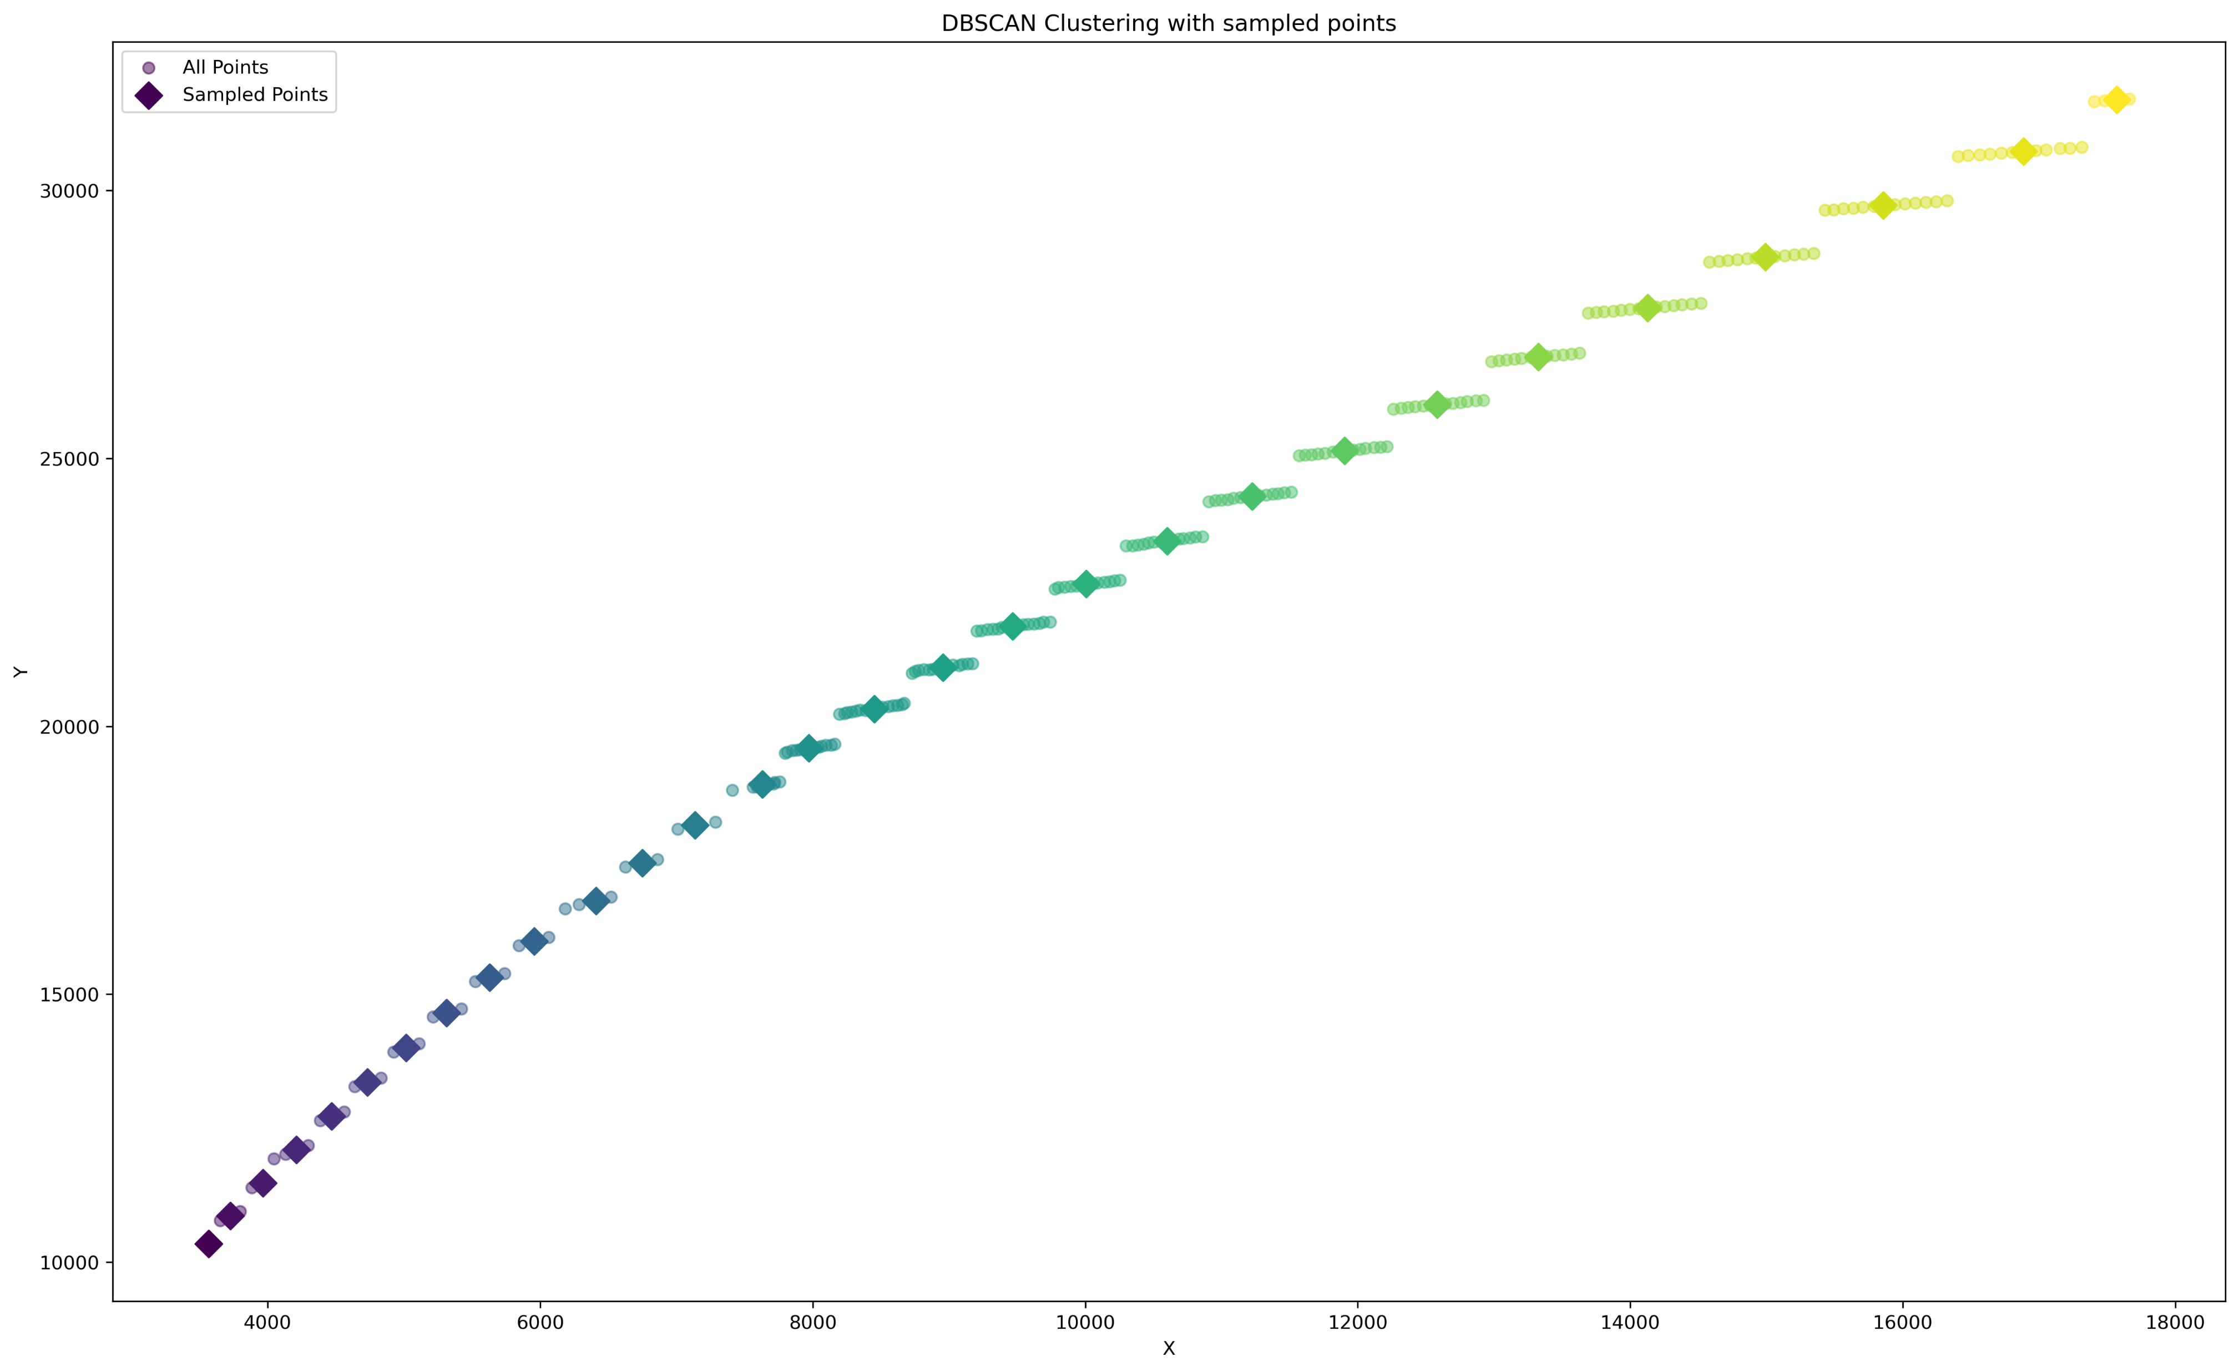

Slide 15
Evaluation
Evaluation of IS algorithms on neural networks
2 Splits
Input (4) --> Hidden (512) --> Hidden (256) --> Hidden (128) --> Hidden (64) --> Hidden (32) --> Output (1)
Reduction percentage
Avg reduction time
Avg best validation MAE , std
Avg best train MAE
Train fold
Reduced dataset
IS algorithms
+
Random sampling
+
Full dataset
Train NN model (scratch)
Evaluation
validation fold
Notes:
Predefined splits (2 times) will split the full dataset into train/test splits where each split enters this workflow in every instance reduction algorithm

Slide 16
Evaluation
2. Regression Autoencoder vs Random Sampling
3 Splits
Reduction: 20%, 80%
Reduction percentage
Avg best validation MAE + std
Avg best train MAE
Train fold
Reduced dataset
Reg autoencoder
+
Random sampling
Train same NN model (scratch)
Evaluation
validation fold
Notes:
Predefined splits will split the full dataset (3 times) into train/test splits where each split enters this workflow in every instance reduction algorithm

Slide 17
Results and Discussion
Notes:
7

Slide 18
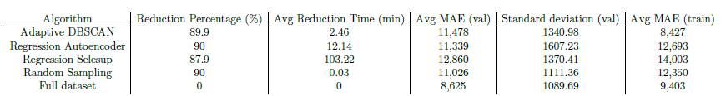
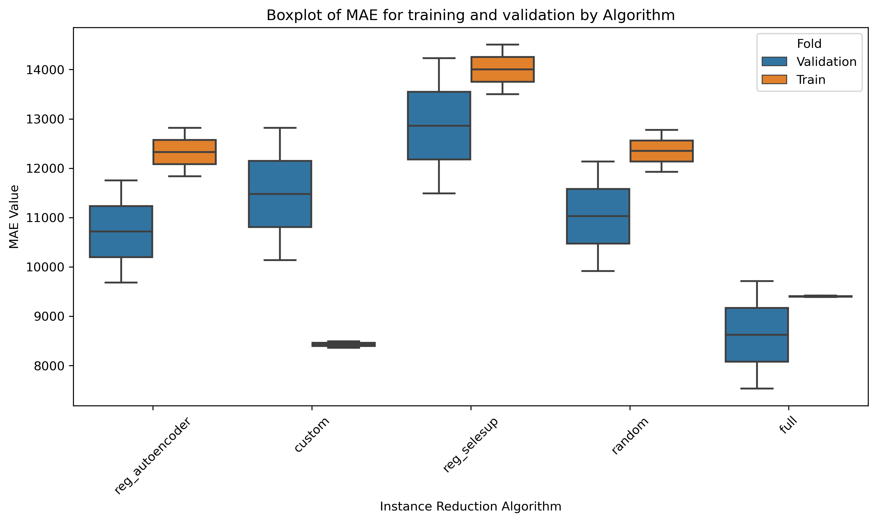
Eval 1
Notes:
All the upcoming algorithms have approx. 90% data reduction (Harsh reduction)
DBSCAN
-> lowest average training MAE score (full dataset noisy/ many redundancy (biased to area with more points) -> impede converging)
-> Worse generalization -> (decrease the pruning percentage, regularization needed)
-> Second lowest running/reduction time.
Regression autoencoder and random sampling almost same performance at this reduction percentage. (maybe at other percentages it would be better) (train reg autoencoder for more epochs) (try FPS)
Regression Selesup most computationally expensive (could be parallelized). Didn’t score well on training/ validation. (increase num NN, non-linearity)
Full dataset (0% red) is best in validation MAE and 2nd best in training MAE.

Slide 19
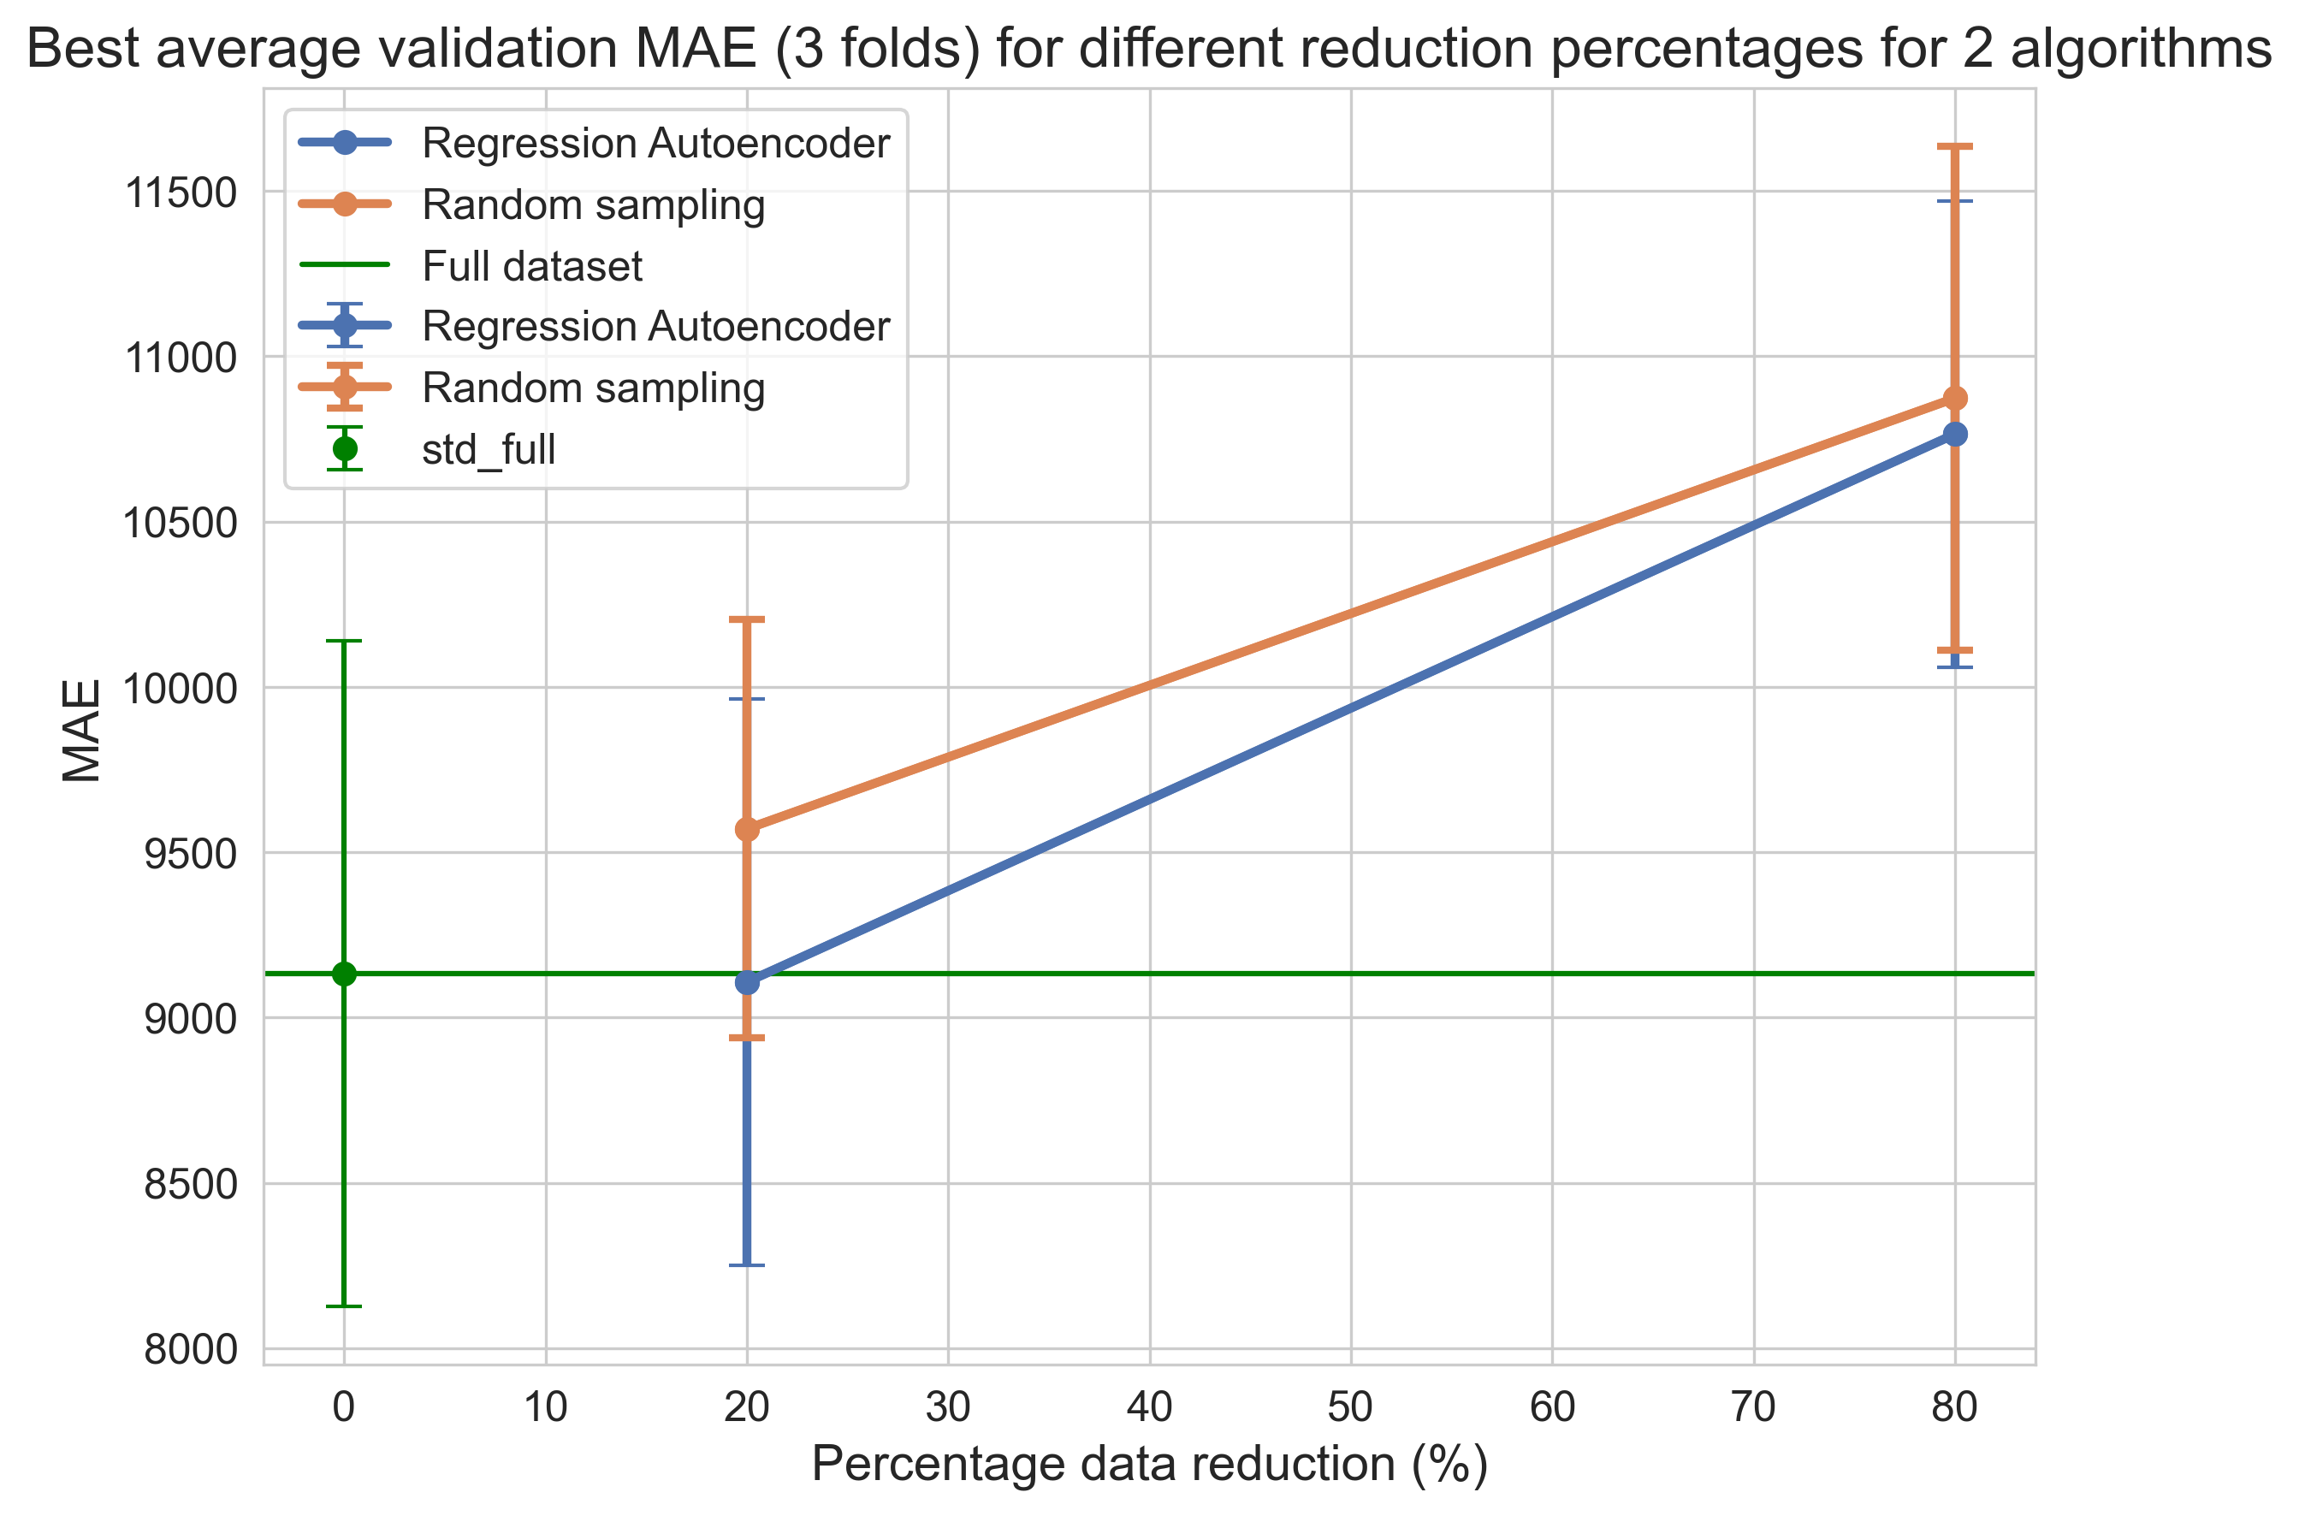
Eval 2
Notes:
Fig shows percent reduction against MAE for reg autoencoder, random, full dataset. Dots-> mean, error bars -> std in each direction.
Reg autoencoder outperformed random sampling at low data reduction percent. (smart grouping + stratified sampling)
As we increase reduction percent, reg autoencoder performs on par with random sampling. Graph assumed linear.
Using only 80% of full dataset (20% reduction), reg autoencoder performed on par with training on full dataset. Lower confidence interval than full dataset.

Slide 20
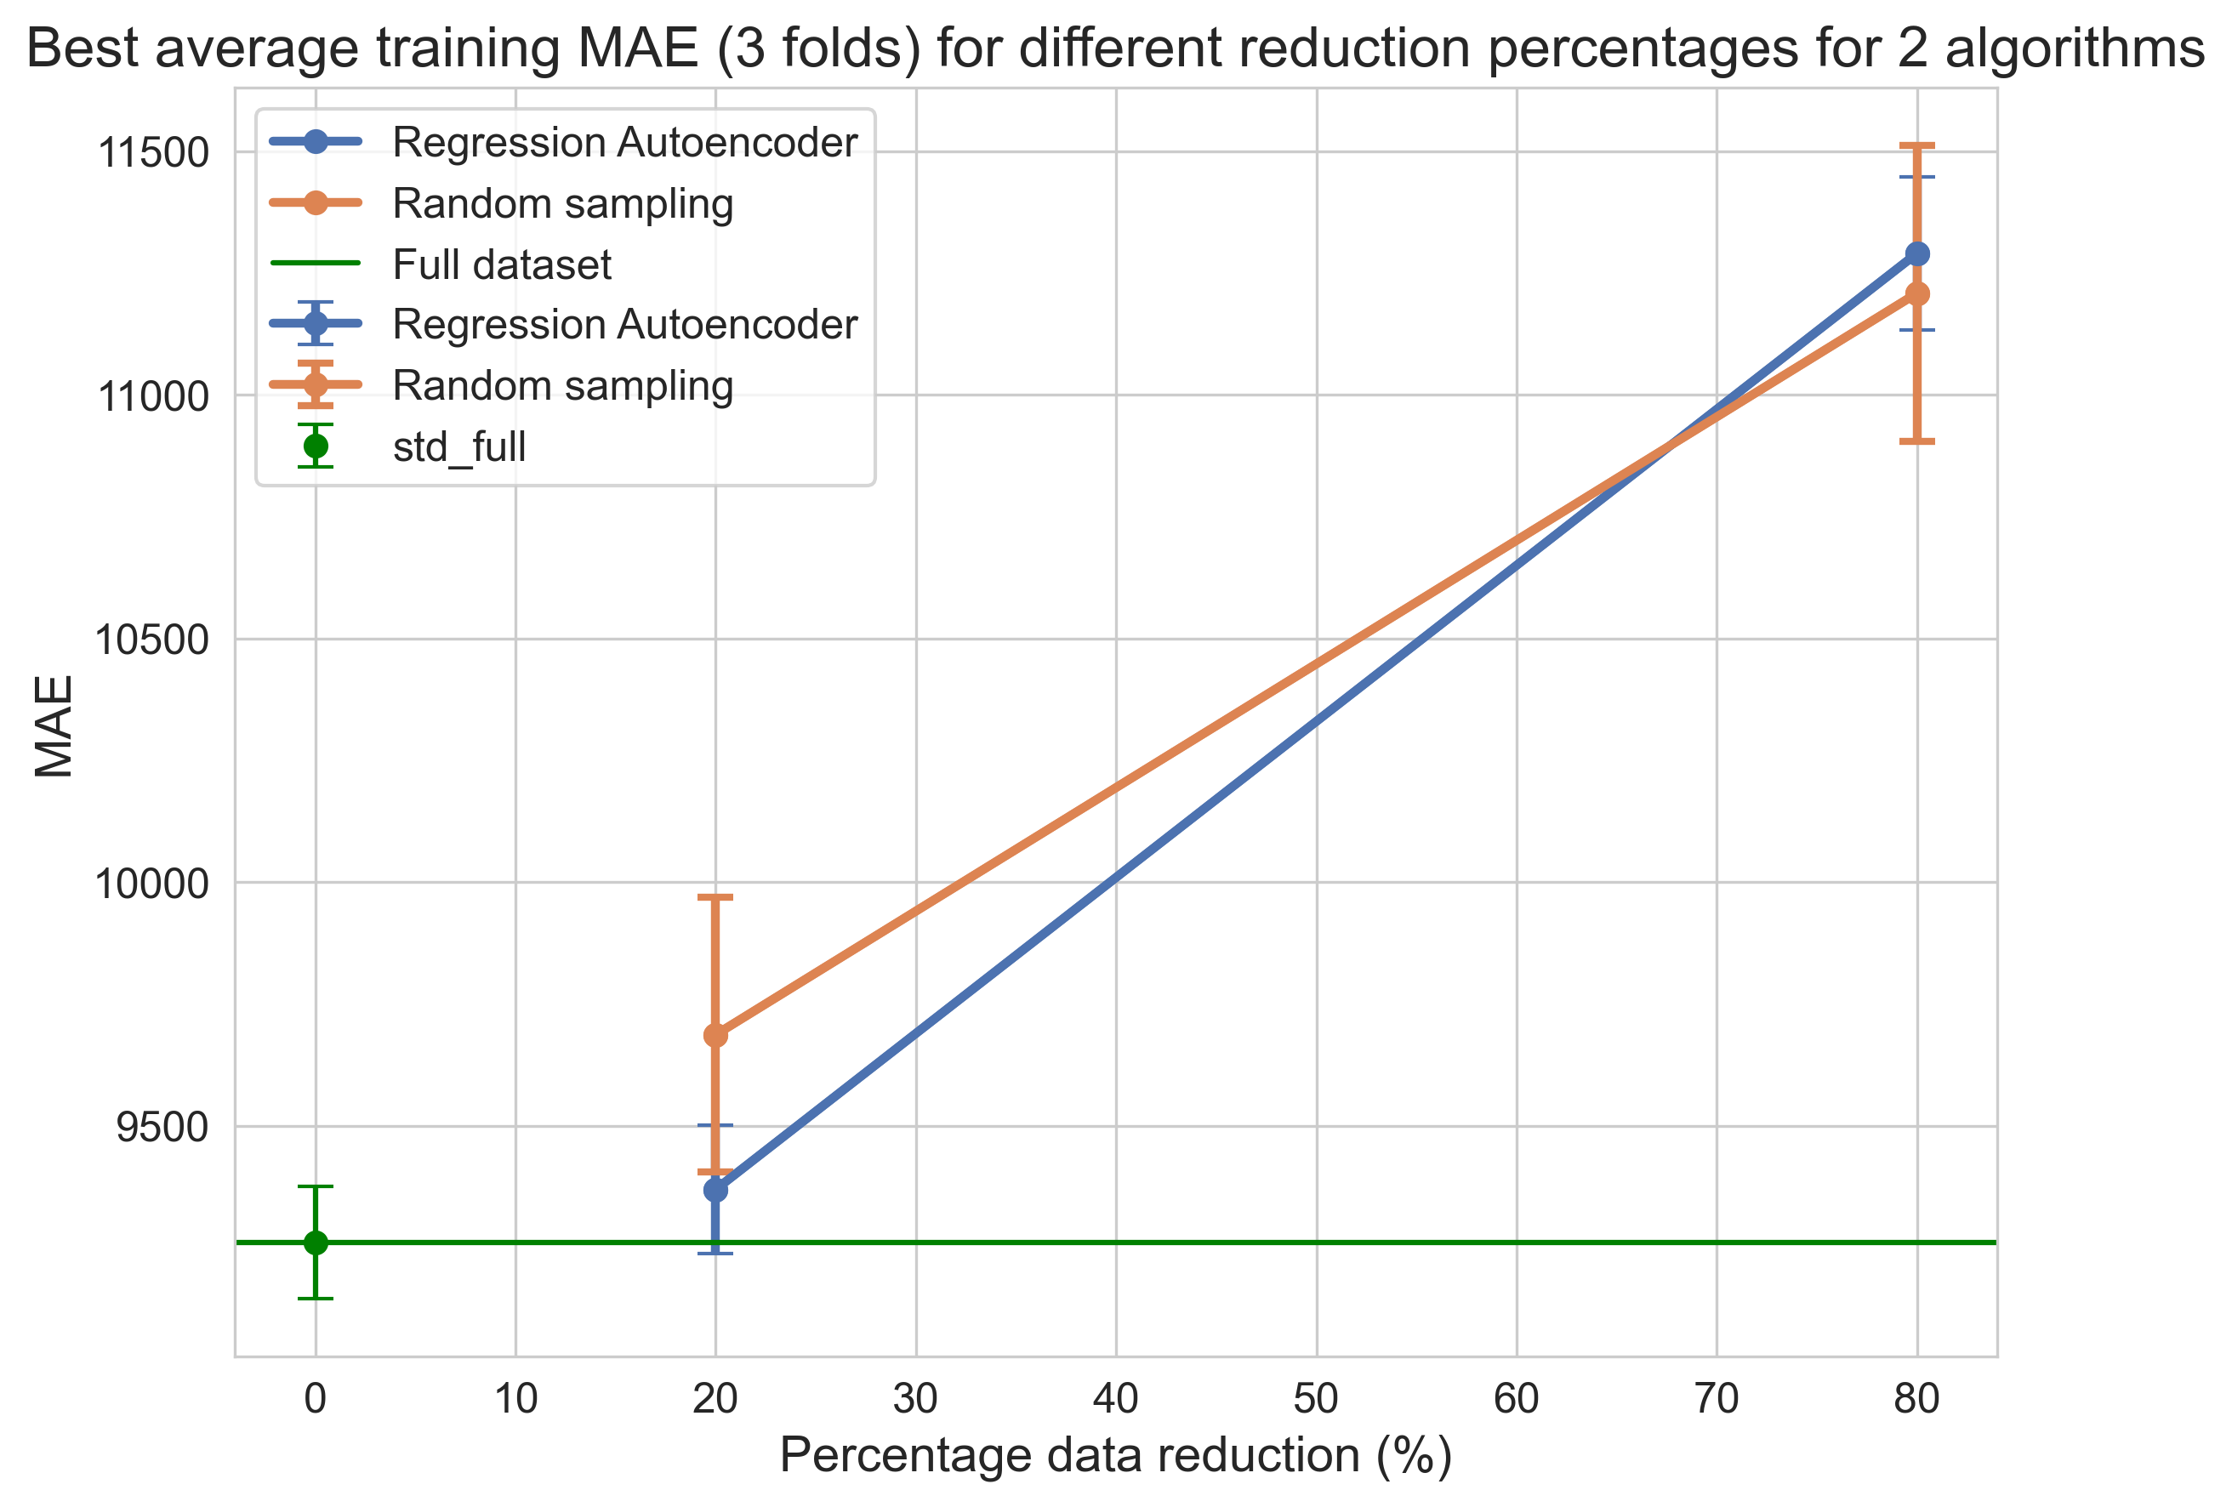
Eval 2

Slide 21
Conclusion and Future work
Notes:
9

Slide 22
Conclusion / Future work
Possible data pruning using representations (embedding)
Adaptive DBSCAN superior in training MAE
Regression Autoencoder outperformed random sampling at low data pruning rates
Training on 10% of data using DBSCAN = training on whole data (train only)
Training on 80% of data from regression autoencoder = training on whole data (train+validation)
Different reduction percentages on other algorithms
Test significance of results on more folds
Using big data frameworks in regression Selesup, account for non-linearity
Try farthest point sampling in regression autoencoder

Slide 23
Acknowledgments
Dr. Grazziela Figueredo Samuel Cartwright Dr. Benjamin Rothwell
Notes:
9

Slide 24
Questions
Notes:
9

